Slide 1
Mobile Food Truck
Safety Training
Part 6: Specifics for Owners/Managers
This material was produced under grant number SH-39170-SH2 from the Occupational Safety and Health
Administration, U.S. Department of Labor. It does not necessarily reflect the views or policies of the U.S.
Department of Labor, nor does mention of trade names, commercial products, or organizations imply
endorsement by the U.S. Government.

Slide 2
Objectives
After this module, the trainee will be able to:
Recognize the benefits of having a proactive safety program
Find resources to develop their own Health and Safety Plans for their workplaces

Slide 3
Today may have a lot of information
Past accidents may scare you
OSHA may scare you
Future lawsuits may scare you
But… you have an opportunity to keep those from happening!
“If you can’t be a good example, you may have to be a terrible warning.” Catherine Aird
You have already taken the first step to improving the safety of your business by attending this course! Keep the momentum going!

Slide 4
Safety Management Mindset
Safety Culture Spectrum
Where are OSHA standards (and others)?
If your only goal is compliance, how easy is it to fall short? What are the consequences?
Where are you on this scale today?
  Can workers bring problems to you, knowing they will be addressed?
  Is there a tendency to be proactive or reactive?
What is your goal? How will you get there?
What challenges/barriers exist?
Ideal- Sustained Safety Culture
Best Practices- Highest Efficiency, Health, Safety
Beyond Compliance-
Improved working conditions
Compliance with Regulations
Not Compliant with Regulations
Notes:
https://www.osha.gov/businesscase/benefits
There are multiple reasons to strive for best practices- safe workplaces (with lower injury rates) spend less on insurance, have lower employee turnover, and have higher employee morale (leading to higher productivity).

Slide 5
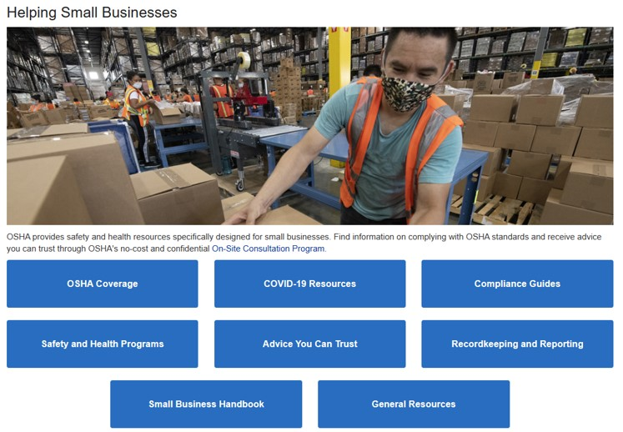
OSHA provides small business assistance
https://www.osha.gov/smallbusiness
Notes:
The above screenshot from the OSHA website, https://www.osha.gov/smallbusiness , which may change at any time

Slide 6

OSHA’s On-Site Consultation Program, SHARP
https://www.osha.gov/complianceassistance/cas
Assistance is available from Compliance Assistance Specialists
OSHA’s website has many resources for small businesses
After you get started, you may want to request assistance for more complicated topics
https://www.osha.gov/consultation
Free Worker Safety/Health consulting services to small businesses
Consulting services are separate from enforcement to assist employers on establishing, improving safety/health programs and achieving compliance
Notes:
OSHA provides Free Worker Safety/Health consulting services to small businesses
The OSHA SHARP Program recognizes small business employers who have exemplary safety and health programs.

Slide 7
Sample Plans and Templates are Available
*These will only work if you apply them to YOUR individual workplace*
Emergency Action Plans (EAPs):
OSHA e-Tool to create your own
OSHA Sample EAP Template
Fire Prevention Plans:
OSHA e-Tool
Sample Fire Prevention Plan Template (NC DOL)
Additional plans are available but may depend on your company’s needs and actual hazards present (i.e. Hazard Communication, Bloodborne Pathogens, etc)

Slide 8
Checklists for Fire Safety, Propane, Fire Extinguishers
https://www.nfpa.org/Codes-and-Standards/Resources/Standards-in-action/Food-truck-safety
You should also check your local jurisdictions- even if they have not updated their fire codes yet, they may sometime in the future
  By being proactive, you can be ahead of changes when they occur
  You can also be a leader in promoting safer work practices with your colleagues- many of them may be neighbors at a future event!

Slide 9
Employer Requirements for Training
Employers must provide training to employees on the hazards present at the worksite. Ensure that workers are trained on:
  Proper procedures for emergencies (Emergency Action Plan)
  Proper procedure for notifying the fire department
  The fire hazards that are present and how to control them
  Proper method of shutting off fuel sources
  Proper procedure to perform leak test on gas connections
  Proper use of portable fire extinguishers and extinguishing systems
  Any other hazards that may affect them in the workplace
If there is not documentation that training occurred, then it didn’t happen.
Keep written records of trainings and other important checks that may back you up if an accident does happen.

Slide 10
Additional Topics that May Apply
Hazard Communication Standards
  Chemicals with Safety Data Sheets (SDSs) including cleaning chemicals
Bloodborne Pathogens (BBP)
  Is there potential exposure to blood or other bodily fluids during an accident? How will this be handled?
OSHA Recordkeeping
  This requirement may depend on the size of your company, how many employees you have

Slide 11
Summary
Employers have several requirements to provide a safe workplace for their workers
OSHA recognizes that small businesses have limited resources, offer their consultative services as assistance
Conclusion: Resources are available to help you make your workplace a safe one for yourself and your workers. Take advantage of it and share your knowledge with others!

